Slide 1
I-Team Summer Session
Summer 2022
Rethinking Active Learning Strategies for Neurodiverse Students
By: Sarira Motaref
June 1st , 2022

Slide 2




Outline
Active Learning
Design Your Activity
Re-Design Process
Neurodiverse Students

Slide 3
Interactions in the classroom
Student-Contents
S-C
Student-Teacher
S-T
Student-Student
S-S
Instructor gives feedback on an assignment or quiz
Instructor gives comments on discussion board
Office hours
Teamwork assignments
Discussion boards
Group projects
Peer review
Think-Pair-Share
Student listens to a lecture
Student watches a video
Student reads the textbook
Make sure to accommodate S-T and S-S
Reference: NETI-3

Slide 4
ICAP Taxonomy
Passive
Active
Constructive
Interactive
Student Watches the course video or listens to lecture (S-C)
Student takes notes while watching video/listening to lecture(S-C)
Student takes a quiz or completes an assignment, participates in a discussion board (S-T)
Student collaborates with other students (zoom Breakout room, collaborate group,…) to complete a project/Assignment (S-S)
ICAP Taxonomy
Reference: NETI-3-ICAP: Interactive-Constructive-Active-Passive Taxonomy

Slide 5

Active Learning-Definition

Slide 6
Active Learning Techniques
Brainstorming
Think-Pair-Share
Clicker questions
Concept mapping
Role Playing
One minute essay
Case study
Have a discussion
Ask Questions
Game Based Learning
Statement correction
Strip sequencing
Group work
Problem solving

Slide 7
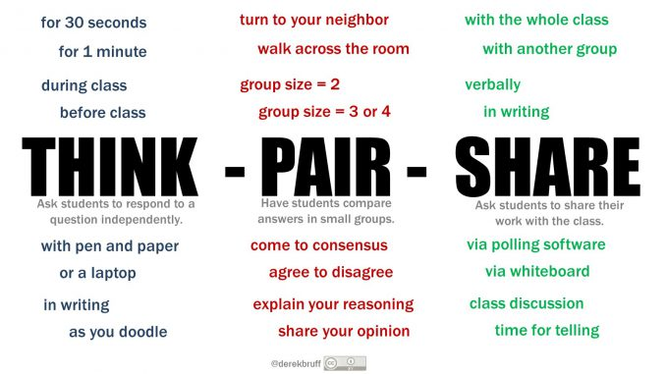
Think-Pair-Share

Slide 8

Brainstorming

Slide 9
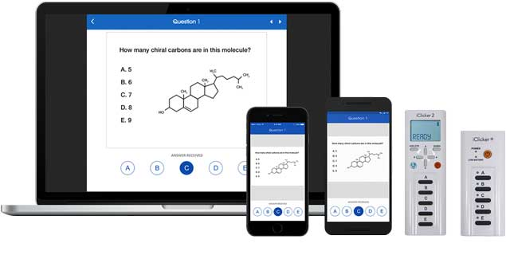
Clicker questions/Polleverywhere

Slide 10
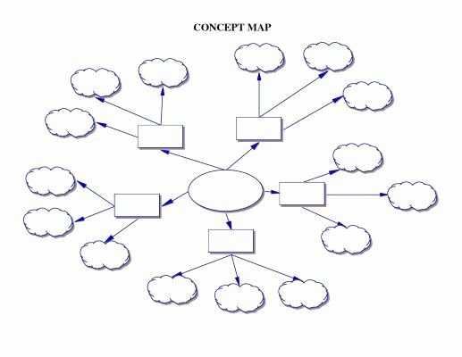
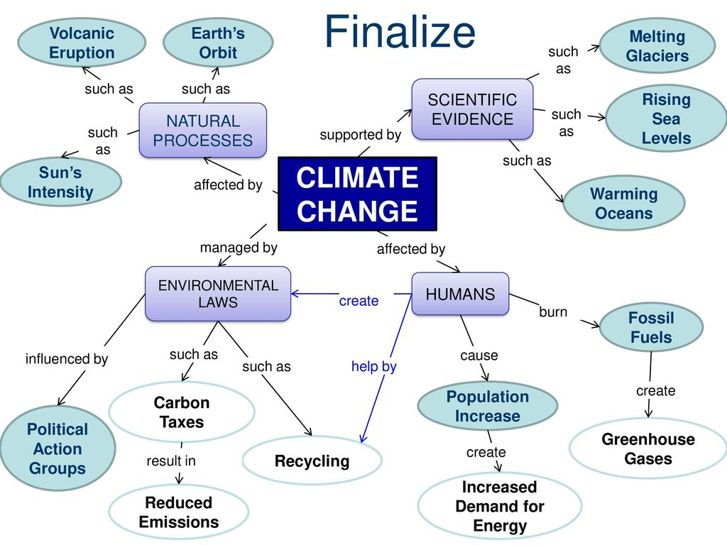
Concept mapping

Slide 11
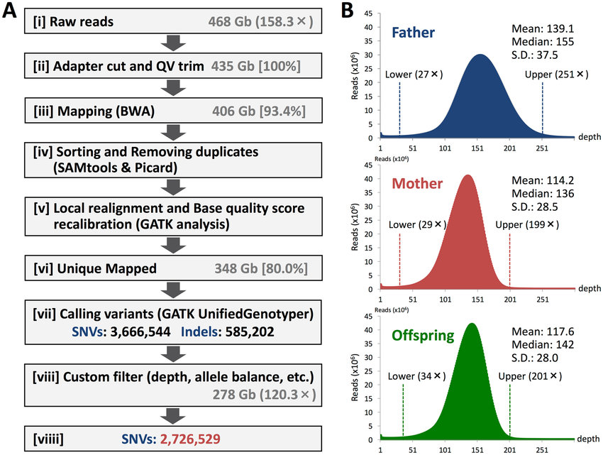
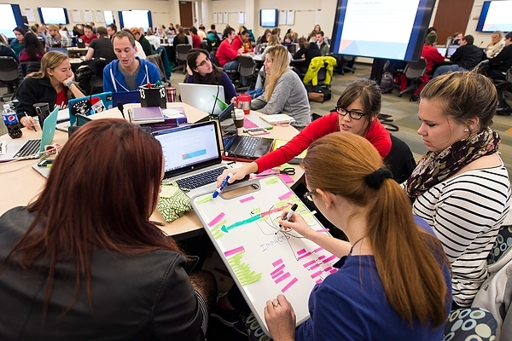
Strip sequencing

Slide 12
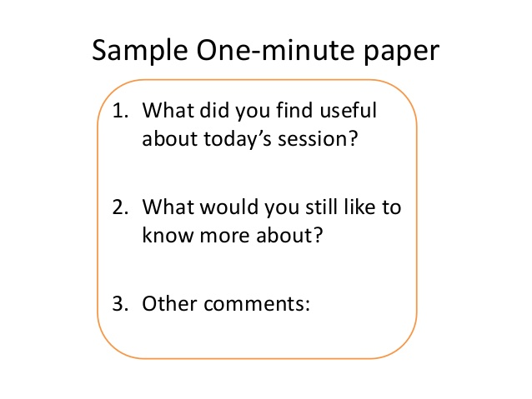


One minute essay=Reflection

Slide 13
Steps to Design and Develop an Active Learning Activity
Step 1: Analyzing needs for implementing an active learning strategy
Step 2: Identify topic and questions
Step 3: Identify learning objectives & outcomes
Step 4: Plan and design the activity
Step 5: Identify sequence of learning events
Step 6: Evaluate and assess

Slide 14
Share one of the Active Learning techniques you use (will use) in your class.
Deliverables:
Your implementation method
Share benefits
Share challenges
Time: 5 minutes

Slide 15


Benefits of Active Learning
Keeping students more engaged than simply watching or listening
Allowing students to reach a deeper understanding of the content
Developing cooperation among students (Student-Student Interaction)
Enabling students to receive timely feedback, which can resolve any misconceptions
Enhancing problem solving skills
Providing an opportunity to discuss more difficult topics in a peer setting

Slide 16
Active Learning Best Practices
Active learning tasks should be aligned with students’ learning objectives
Provide clear and specific instructions to students before the session.
Assign roles and responsibilities for any group work, collaboration, discussions or debate.
Clarify the outcomes (deliverable) by students for each activity
Provide verbal feedback that is consistent and fair
Make students accountable by assigning small credit/reward

Slide 17


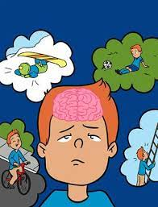
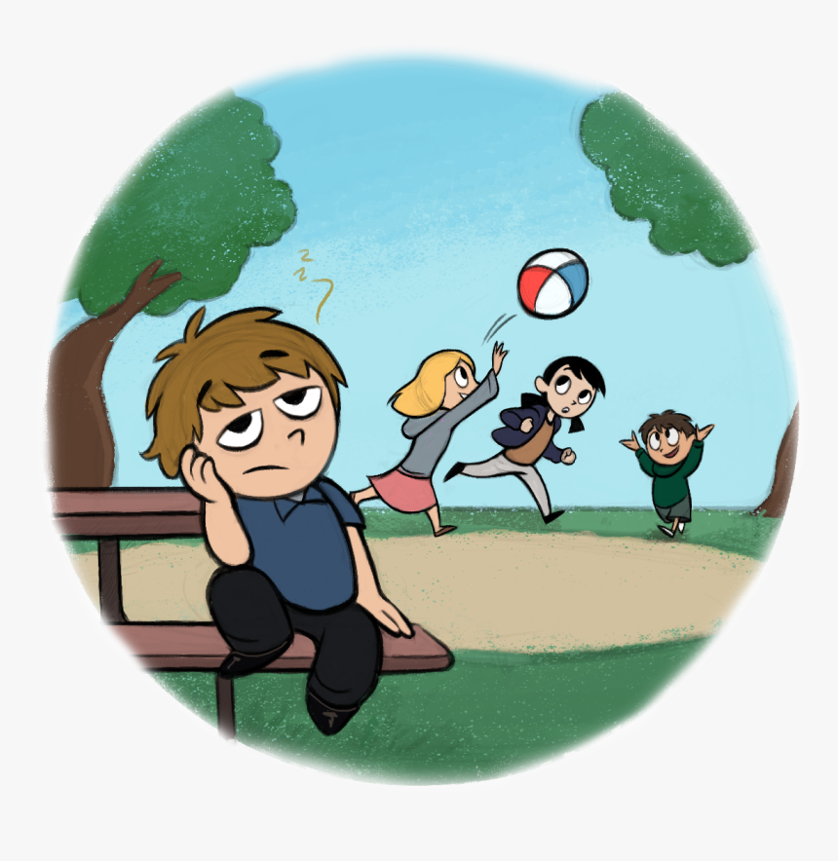
Neurodiverse Students and Active Learning
Traumatic Brain Injuries
ADHD
Dyslexic
Autistic

Slide 18
ADHD Students
Strengths
Challenges
creative minds
curiosity
leadership abilities
stamina (the ability to sustain prolonged physical or mental effort)
amazing gifts in specialized areas like computers, math, music, etc.
Adventurousness
Looking at the Big Picture
Thinking Outside the Box
Lots of Energy
Hyperfocus
Divergent thinking
Overlooks the details of school work
Finds it difficult to follow instructions
Struggles with organization
Has trouble focusing when being spoken to
Does not complete school work or chores in a timely manner
Avoids doing tasks that require great focus (ie: homework)
Frequently loses track of items such as homework and possessions

Slide 19
Dyslexic Students
Strengths
Challenges
Difficulty reading, including reading aloud
Spending an unusually long-time completing tasks that involve reading or writing
Difficulty memorizing
Difficulty doing math problems
Have difficulty keeping track of multi-step directions
Struggle with getting the hang of telling time
Find it difficult to take notes and copy down words from the board
Seeing the bigger picture
Good spatial knowledge
Picture Thinkers
Sharper peripheral vision
Business entrepreneurs
Highly creative
Thinking outside the box – problem solving

Slide 20
Autistic Students
Strengths
Challenges
• Strong long-term memory skills
• Math, computer, musical, artistic skills
• Thinking in a visual way (Visual Learner)
• Punctuality (the fact or quality of being on time)
• Detail oriented
• Independent thinking,
• Non-judgmental listening
• Extensive knowledge resulting from deep study in favorite topics
• Understanding rules and sequences
• Logical thinking that is helpful in decision-making process
• Intensive focus when working on a favorite activity
• Hard time motivating
• Difficulty of focusing on something other than interest
• Following unwritten social rules; these rules can be learned through instructions
• Unbalanced set of skills
• Difficulty with generalization concepts
• Trouble with functioning, hence difficulties in planning long-term activities
• Perceiving emotions of other people

Slide 21
Traumatic Brain Injuries (TBI)
Challenges
Physical changes: tiredness; lack of interest; headaches; awkward movements; slowed reactions; heightened sensitivity to light or noise.
Cognitive (thinking) changes: forgetfulness; difficulty learning new material; word-finding difficulties; problems with organizing materials; easily distracted.
Emotional changes: unable to deal with minor changes in the environment or daily routine; little or no expressed emotion; depression.
Behavioral changes: irritability; inability to deal with unexpected event.

Slide 22
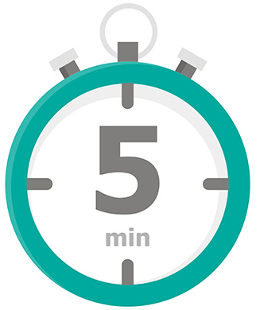
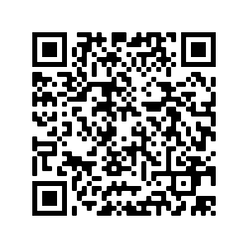

Enhancing the Active Learning for a more Inclusive class
Redesign one of the active learning plan for Neurodiverse students.
Time: 5 minutes
Sharing: Verbal or written In Google Jamboard
https://jamboard.google.com/d/1kiwyMD6FmNPCFK-YryeO6pTzgkPmytuY-N3v7rLHtDo/edit?usp=sharing

Slide 23
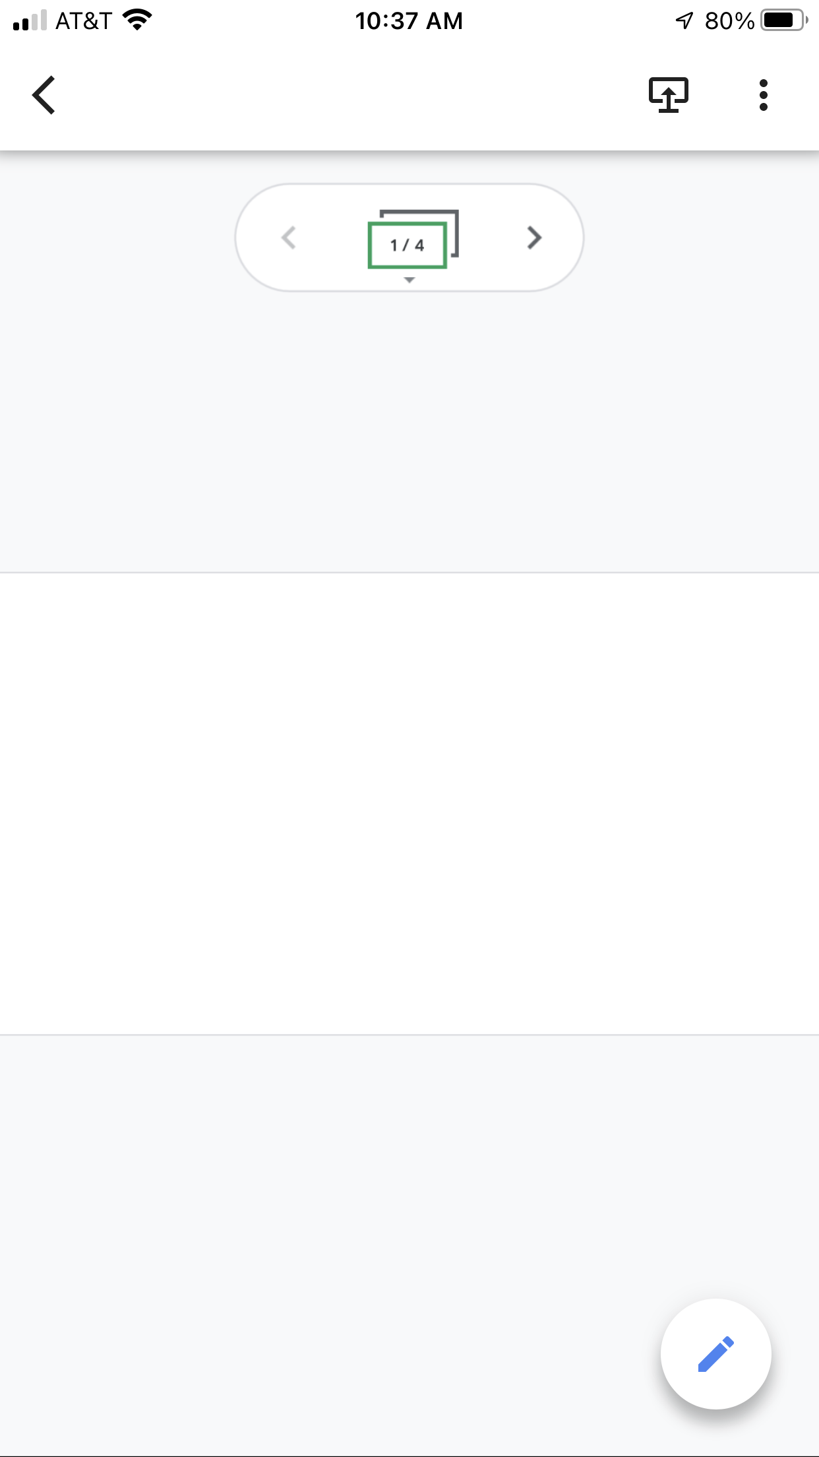
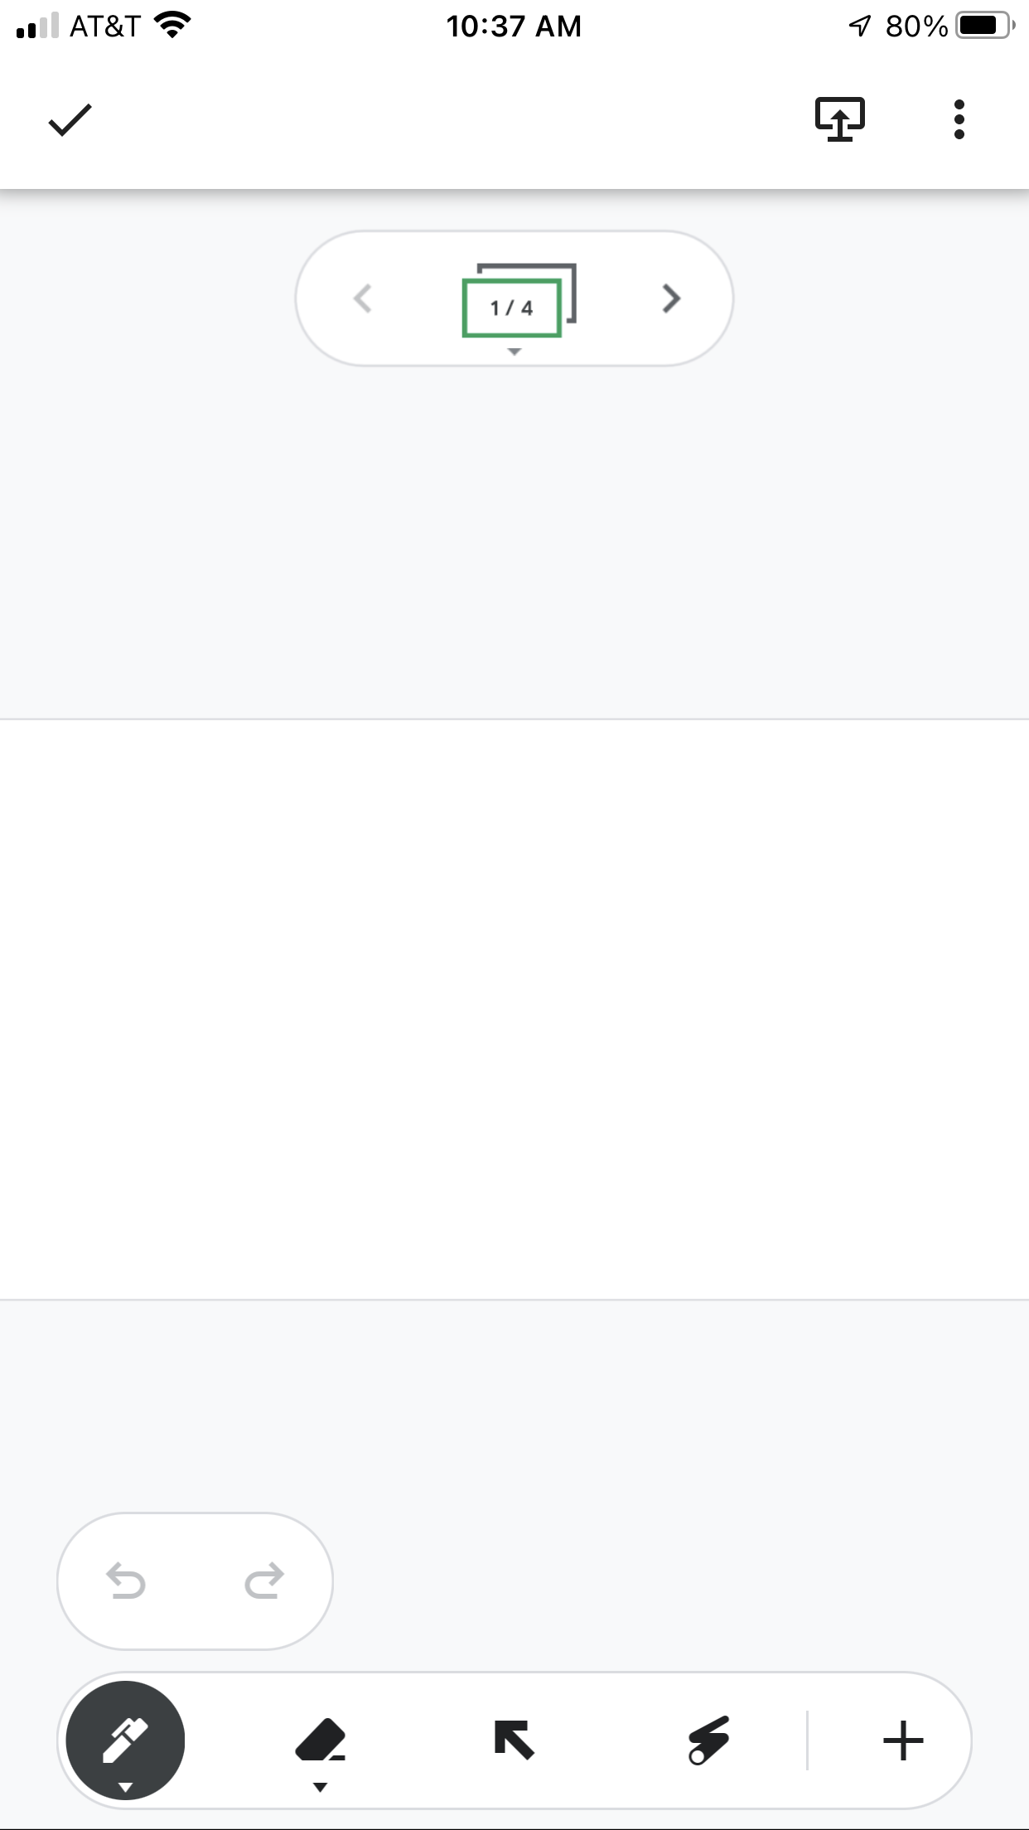
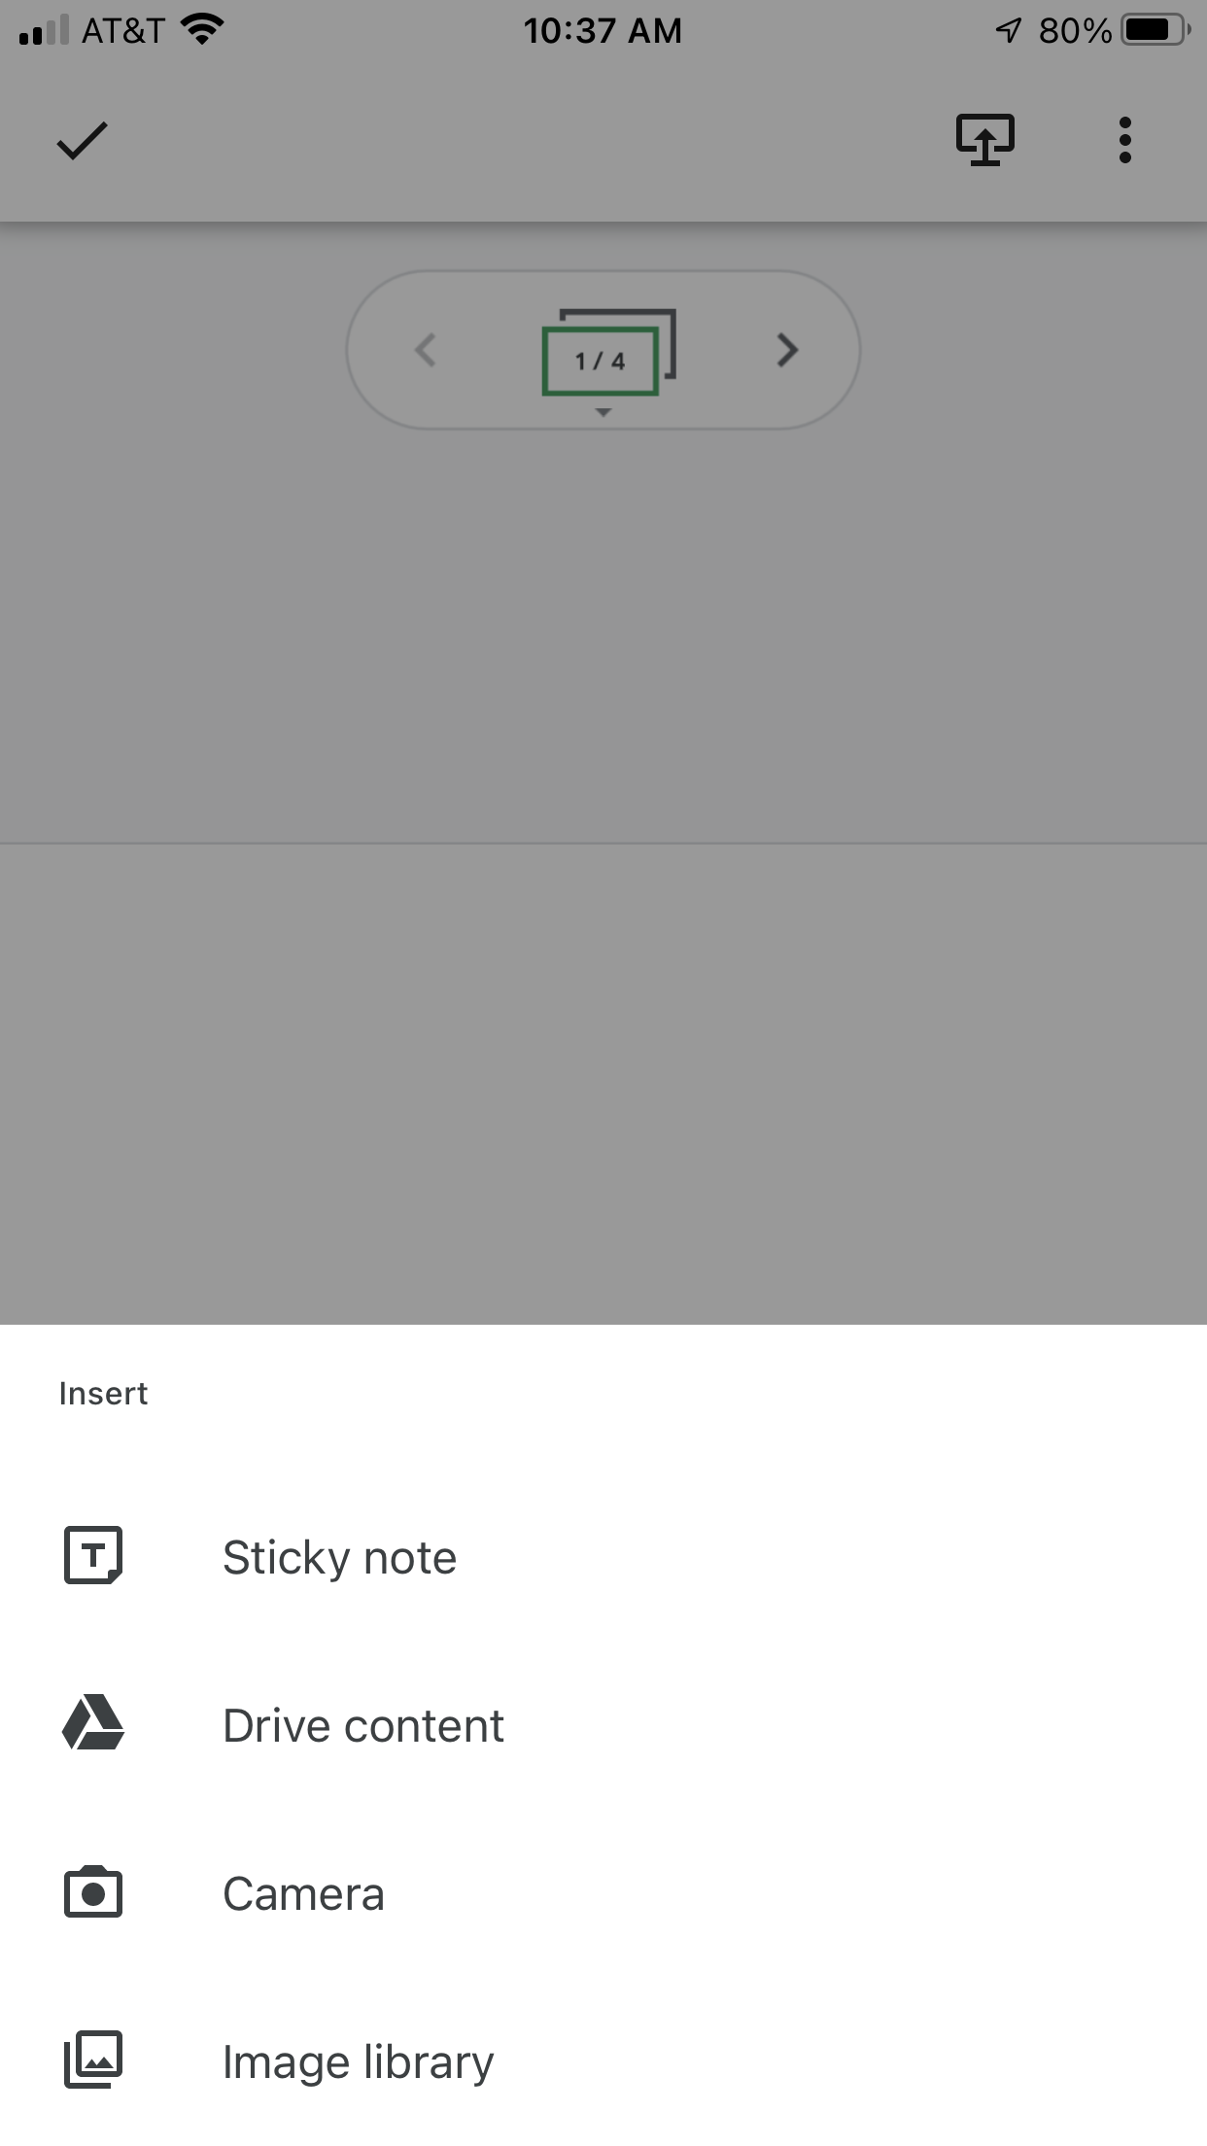
How to use Jamboard on your cellphone

Slide 24
Suggested deliverables
General structure/instruction for the activity
Flexible options you may provide to students
Role assigning procedure
Flexibility in time for the activity
Acceptable formats of presentation
Grading

Slide 25
How to accommodate?
Be flexible with the group versus individual work
Be flexible with the final presentation format
Be flexible with the timing (if possible)
Employ Neurodiverse students’ strength when assigning roles
Encourage creativity
Use visualization as much as possible

Slide 26

Summary
Facilitate Student-Teacher and Student-Student Interactions
Offer more Constructive and Interactive activities
Design your Active learning and use best practices
Awareness about Neurodiverse students in your classroom and modifications you may make on your activity
Find a balance between lecturing and active learning.

Slide 27

Questions?
Email me your questions: Sarira.Motaref@uconn.edu

